Slide 1
Project II Exploratory Data Analysis
By DR. RajAS Khokle
For DSI – V
Notes:
The first part of the project is guided by the problems asked in the python notebook whereas the second part is left open.

Slide 2
High School Education in USA
A Data Analysis Report

Slide 3
Data Description
The dataset has 52 data rows and 4 columns
State Datatype - Object - The Abbreviation of the State in USA.
Rate Datatype - Integer - Standardized SAT participation.
Verbal Datatype - Integer - Average Scores for Verbal Tests.
Math Datatype - Integer - Average Scores for Math Test.

Slide 4
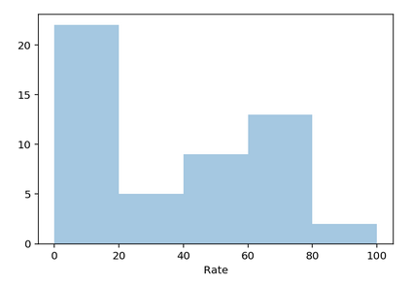
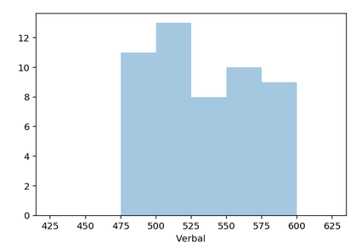
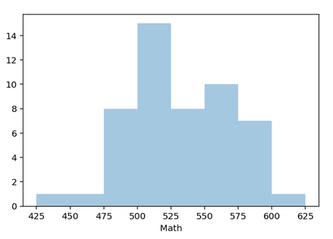
Distribution Plots
There are about 22 states with participation rate less than 20.
The maximum number of states have verbal score from 500-525.
The maximum number of states have math score between 500 – 525.
The range of scores for Verbal is less than Mathematics.

Slide 5
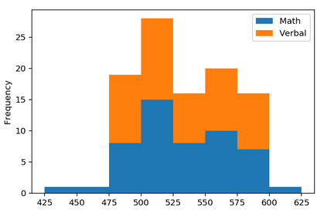
Stacked Histogram
The stacked histogram shows how the behavior of Verbal score is similar to that of the math score, i.e. they are highly correlated.
The math score is more range but the frequency of operation beyond the range of 475 – 600 is negligible (3 states outside this range).

Slide 6
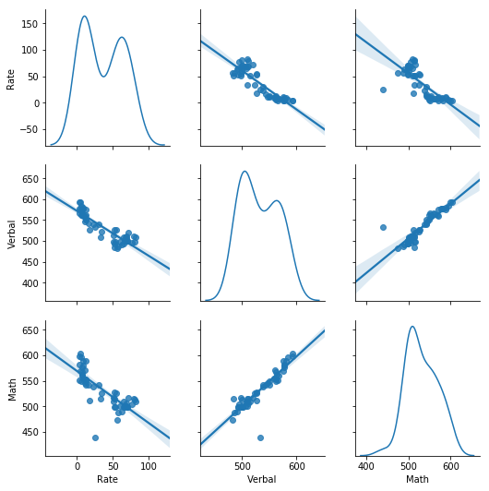
Pairplot
Both verbal and math abilities are inversely related to the rate.
The math skill is directly proportional to the verbal skill with very high linear relation and low spread.
The rate and verbal skills have bimodal distributions whereas maths has a log -normal distribution.

Slide 7
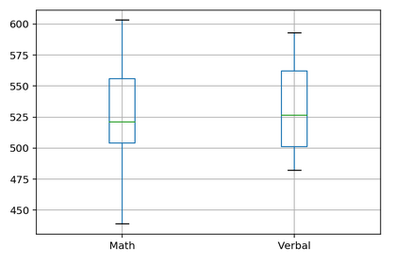
Boxplots
The range in math scores is larger than that of verbal score whereas the IQR is smaller for math score than verbal score.
Also, the average of Verbal Score is higher than the math score.

Slide 8
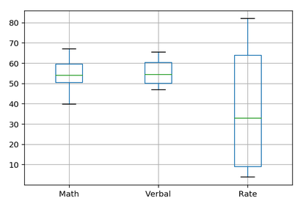
Normalized Boxplot
The verbal and Math scores are normalized for scores between 200 - 800 and converted to percentages to enable boxplot comparison with Rate.
The spread and IQR of participation rate is much higher than the scores but the average is small (about 32)

Slide 9
Conclusion on SAT score
The EDA on SAT scores dataset suggests that the verbal and math score are highly correlated. Therefore, to increase one, other has to be increased as well.
The average verbal and math scores are 532 and 531.5, While their median scores are 527 and 525, respectively.
The Math score has higher standard deviation than the Verbal Score.
It is interesting to note that the minimum math score is 43 less than minimum verbal score across the USA, but the minimum difference between two scores is 30.

Slide 10
Drug Abuse in USA
A Data Analysis Report

Slide 11
Data Overview

Slide 12
Data Description
Age: Age ranging from 12 years to 65+.
N: Number of samples for a particular age group.
Drug – Use : Percentage of those in an age group who used drug in the past 12 months.
Drug – Frequency : Median number of times a user in an age group used the drug in the past 12 months.
Drug – Amount = Drug – Use X 0.01 X Drug – Frequency (Derived Quantity)

Slide 13
Deliverables
Cleaned data with outliers identified and removed or imputed.
Statistics on Drug usage by different groups.
Which age group is the highest drug abuser?
Is there any correlation between the % of population using drugs?
Is there any correlation between the frequency of different drugs?
How are minors abusing drugs?

Slide 14
Initial Overview of the data - Drug Frequency

Slide 15
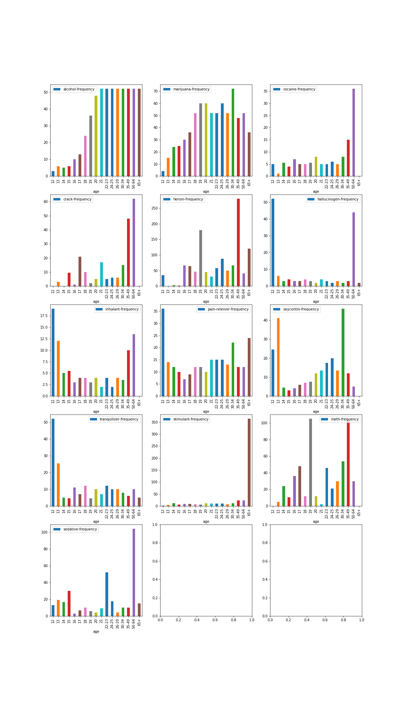

Slide 16
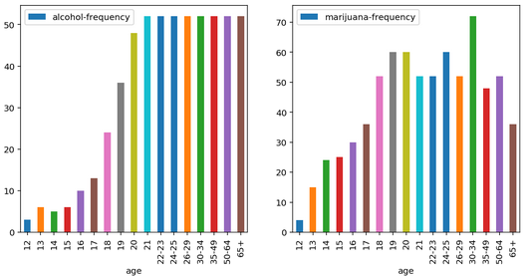
Alcohol and marijuana are most consistently and highest abused drugs across all the ages greater than 21.

Slide 17
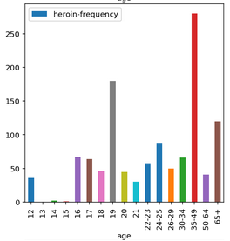
Heroin has highest frequency of use. The most frequent abuser of heroine is the age group between 35 -49.
There are some number for heroin use by 12 year old children. This seems to be an outlier and can be replaced with number for 13 year old children.

Slide 18
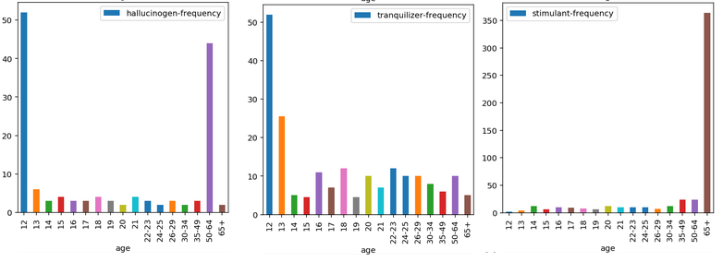
Possible Outliers : -
It seems very unnatural that a 12 year old will consume 10 times more hallucinogens than any other age group. The data can be replaced with that of 13 year old. Similarly, for the age group between 50-64, the data is replaced with the mean of 35-49 and 65+ data.
Also, a 12 and 13 year old may not consume tranquilizers 5 times more than the adult population. It can be replaced with that of a 14 year old.
Further, stimulant consumption for 65+ year old cannot be more than 350, when for rest of the population it is less than 30. It can be replaced with the value equal to 50-64 year age group.

Slide 19
Drug Frequency
Alcohol and marijuana are most consistently and highest abused drugs across all the ages greater than 21. People consume it once every week (about 52 times an year).
Heroin has highest frequency of use for the age group of 35 - 49. It is more than 260 times in one year by this age group.
Cocaine(35/year), crack (60/Year), stimulants (Once a day), and sedatives (100/year) are highly abused by people of age greater than 50.
Tranquilizers, pain relievers, inhalants and Oxycontin are frequently used by children below 15 years of age.
Inhalants, Cocaine, and pain relievers are least frequently used drugs.

Slide 20
Initial Overview of the data - Drug Use Percentage

Slide 21
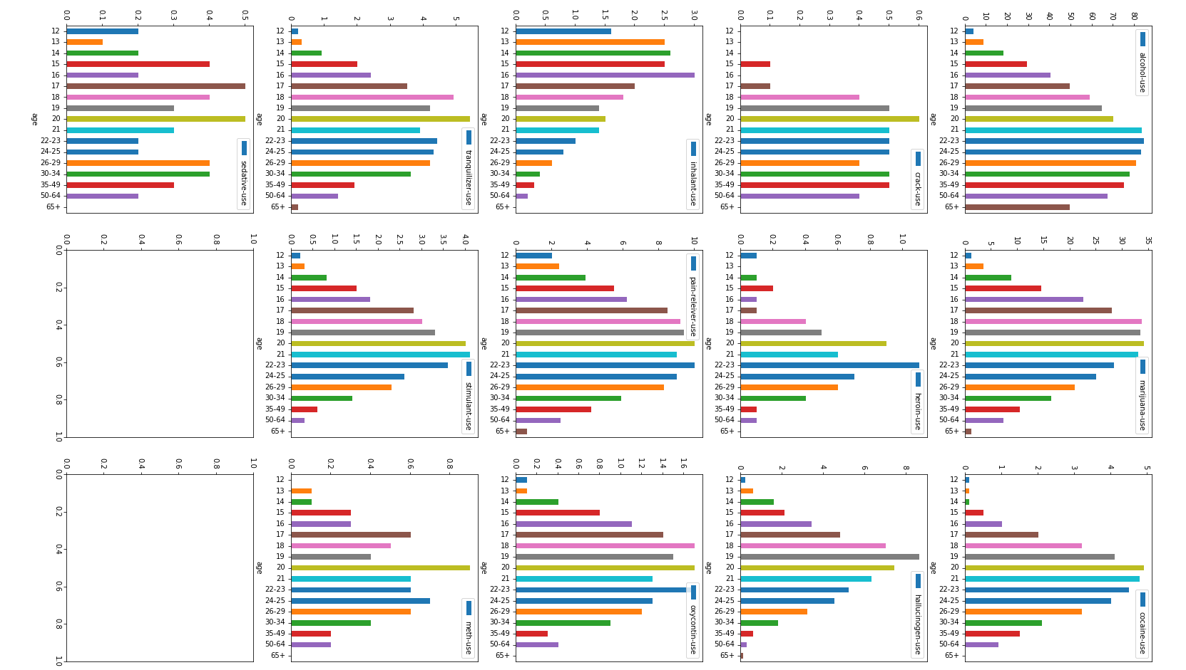

Slide 22
Initial Overview of the data - Drug Use Amount

Slide 23
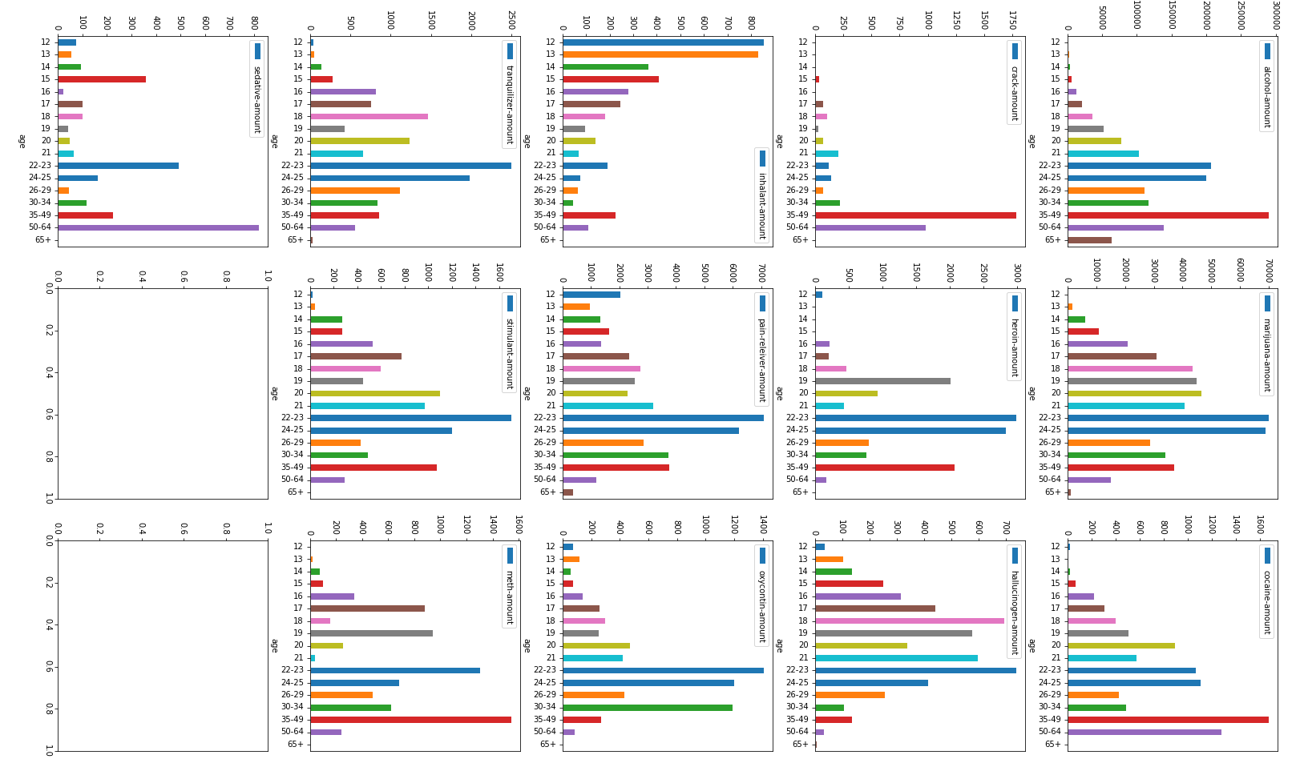

Slide 24
Drug Amount Inference
The amount of drug use, i.e. number of users X median frequency of usage shows that the age group of 22 -25 highly abuses majority of drugs that include marijuana, heroine, hallucinogens, pain-relievers, oxycontin, tranquilizers, stimulant, and meth.
The maximum amount inhalants is consumed by 12-15 year old minors.
Cocaine and Crack is highly abused by people in 35 - 49 age group.

Slide 25
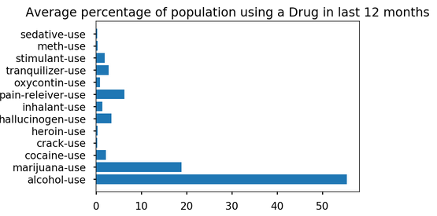
Drug Average Statistics – Use

Slide 26
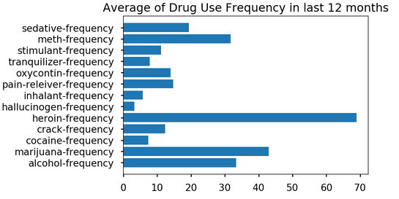
Drug Average Statistics – Frequency

Slide 27
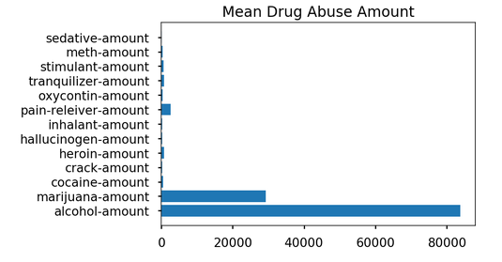
Drug Average Statistics – Amount

Slide 28
Drug Classification
The data on 13 drugs is available in the dataset.
They can be broadly classified into 3 groups
Nerve Depressants - Alcohol, Heroin, Pain relievers, Oxycontin, tranquilizers, and sedatives.
Nerve Stimulants - Meth, cocaine, crack and stimulant.
Hallucinogens - Inhalants, Marijuana and other hallucinogens.

Slide 29
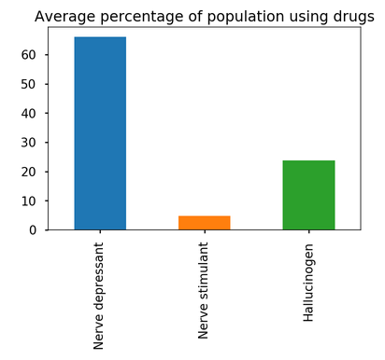
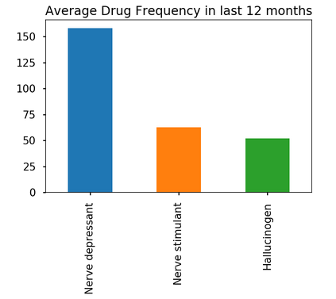
There are large number of people who use Nerve depressants followed by Hallucinogens and a small amount of people use nerve stimulants.
The frequency of use of nerve depressants is highest, followed by almost equal frequency for nerve stimulants and hallucinogens.
Why people want to suppress the intelligence developed through millions of years of evolution?

Slide 30
Drug Correlation - Use

Slide 31
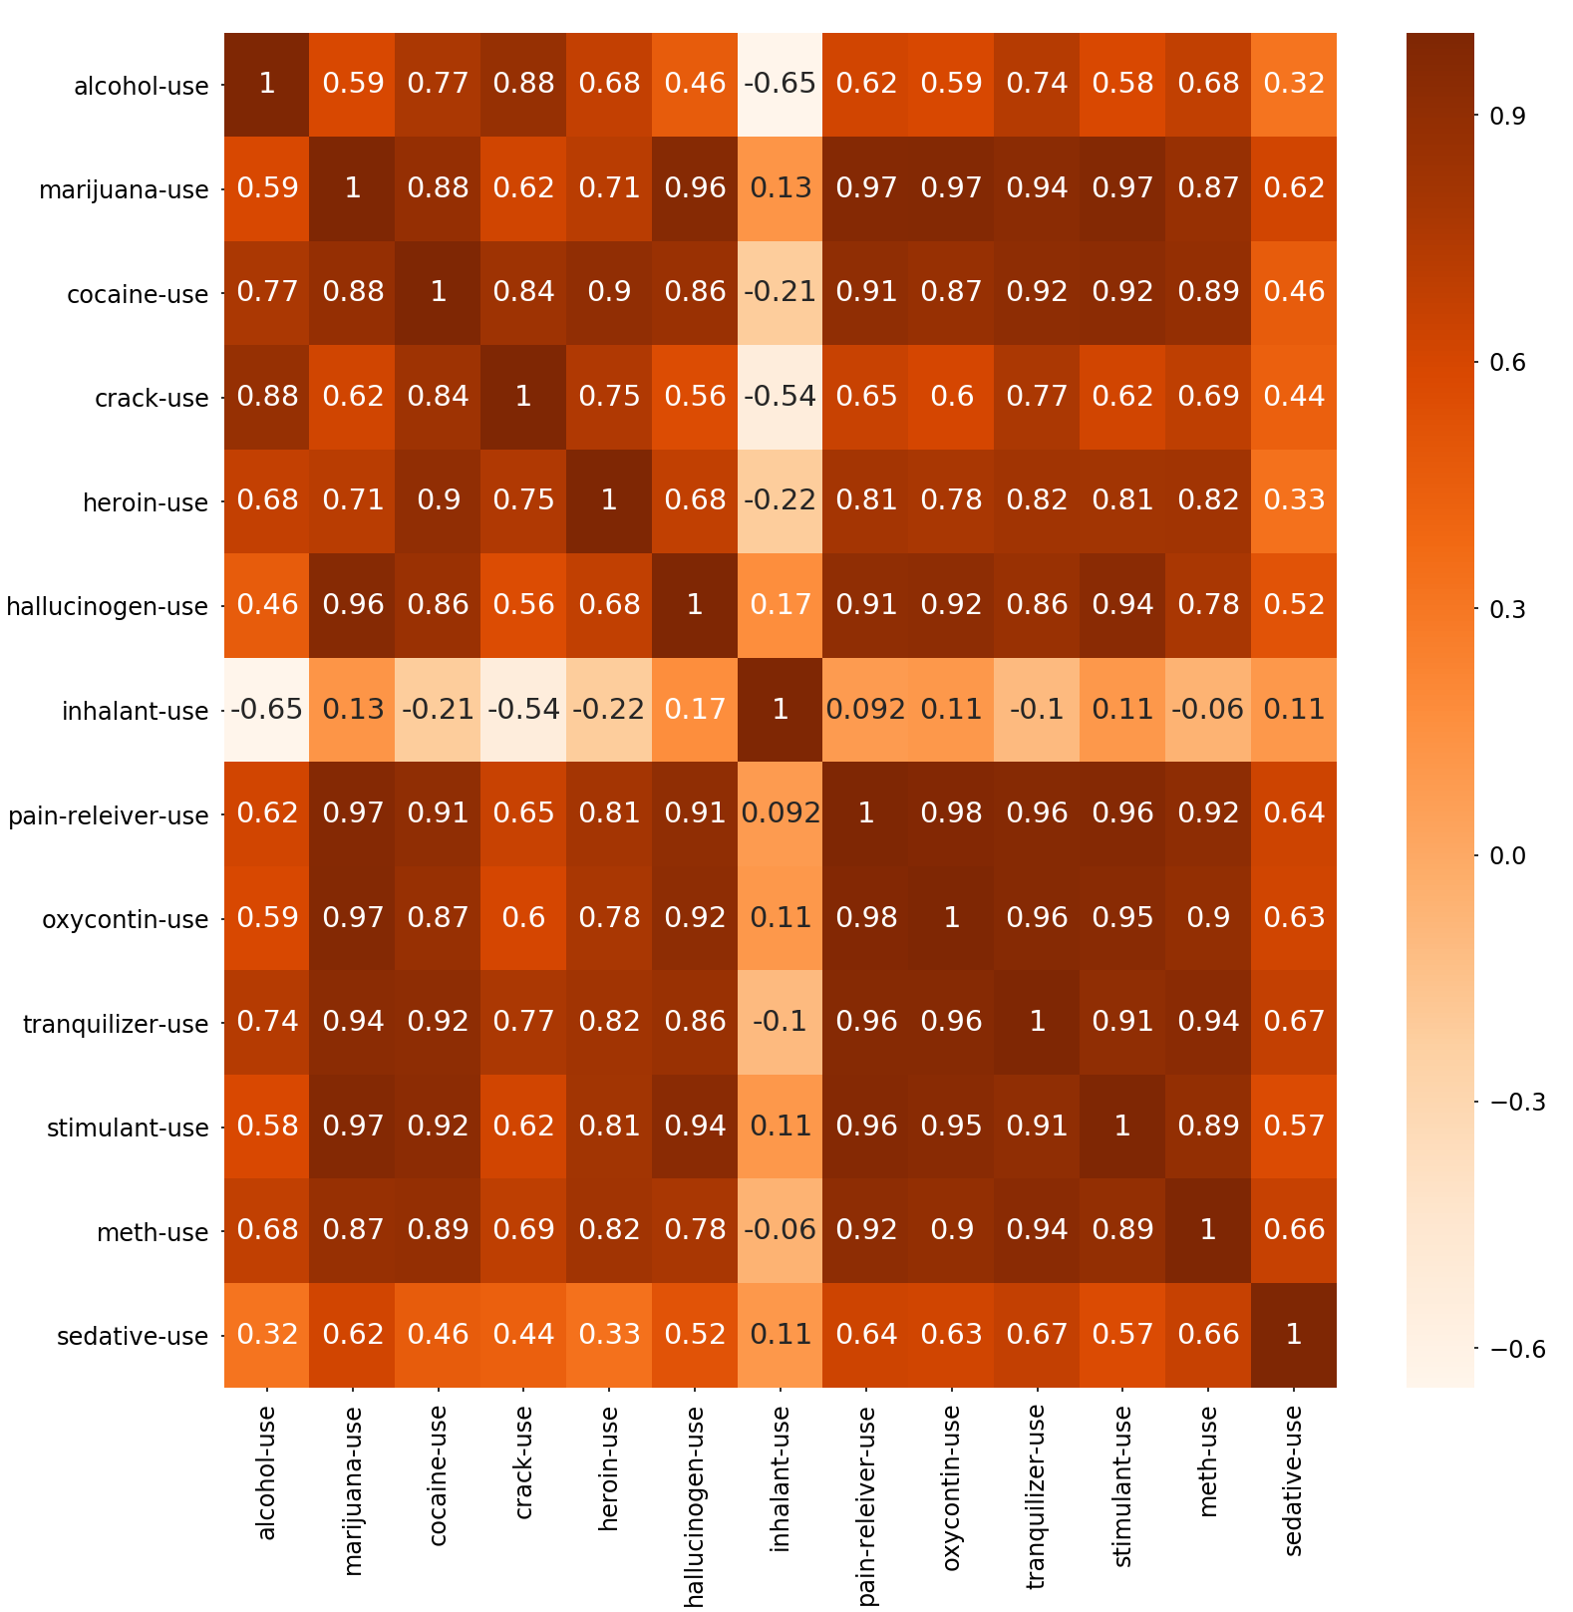
Inhalant use is not correlated with others as it is frequently used by minors as opposed to the adults.
Use of all other drugs are positively correlated. This means that people using one type of drug are also prone to use other drugs as well.
Tranquilizers use is highly correlated with pain-relievers, oxycontin, meth, marijuana, cocaine and stimulants.
Marijuana use is highly correlated (> 0.95) with hallucinogens, tranquilizers, Oxycontin, Pain-reliever, and stimulant.
Alcohol and sedative use is not correlated so highly with other drugs.

Slide 32
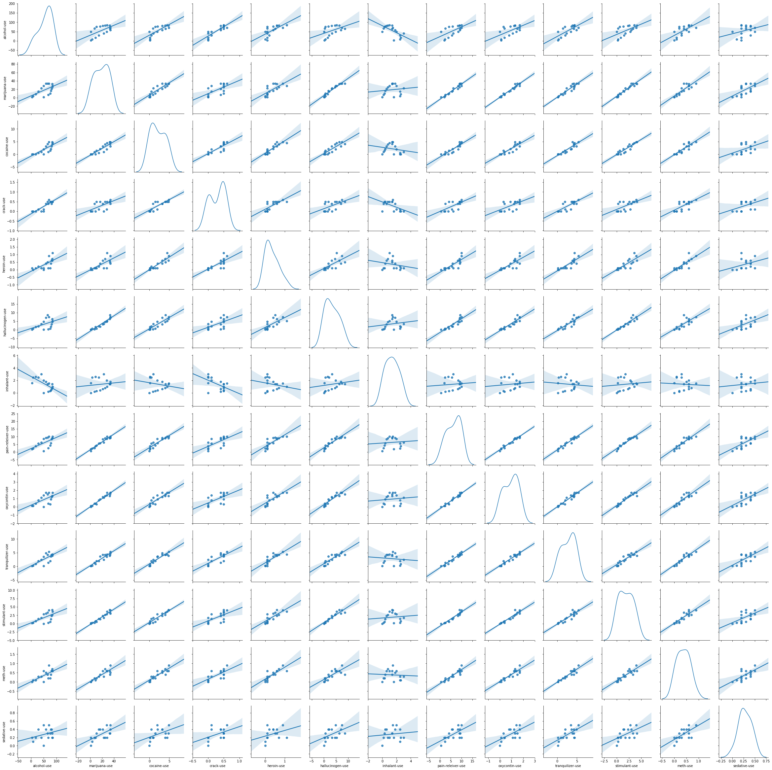

Slide 33
Drug Correlation - Frequency

Slide 34
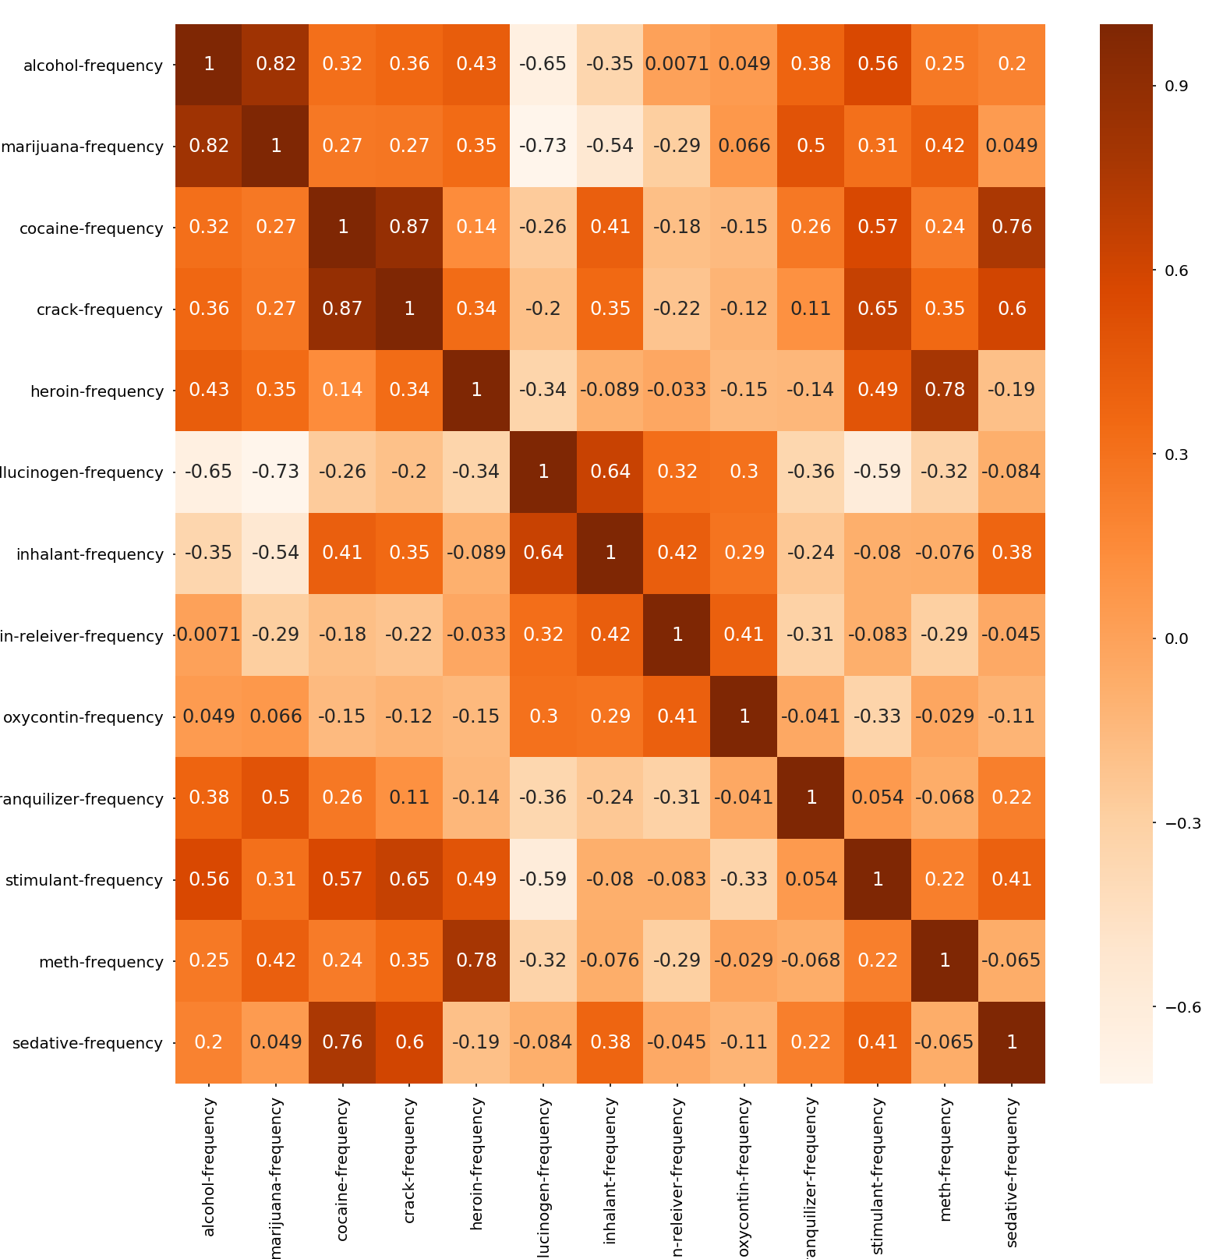
The maximum correlation for drug frequency is seen for following drugs.
Crack - Cocaine - 0.87
Cocaine - Sedative – 0.76
Crack –Sedative – 0.6
Alcohol - Marijuana - 0.82
Marijuana - Hallucinogen - (-0.73)
Alcohol – Hallucinogen – (-0.65)
Meth - Heroin - 0.78

Slide 35


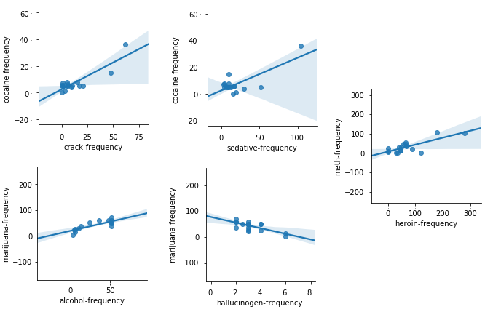




Slide 36
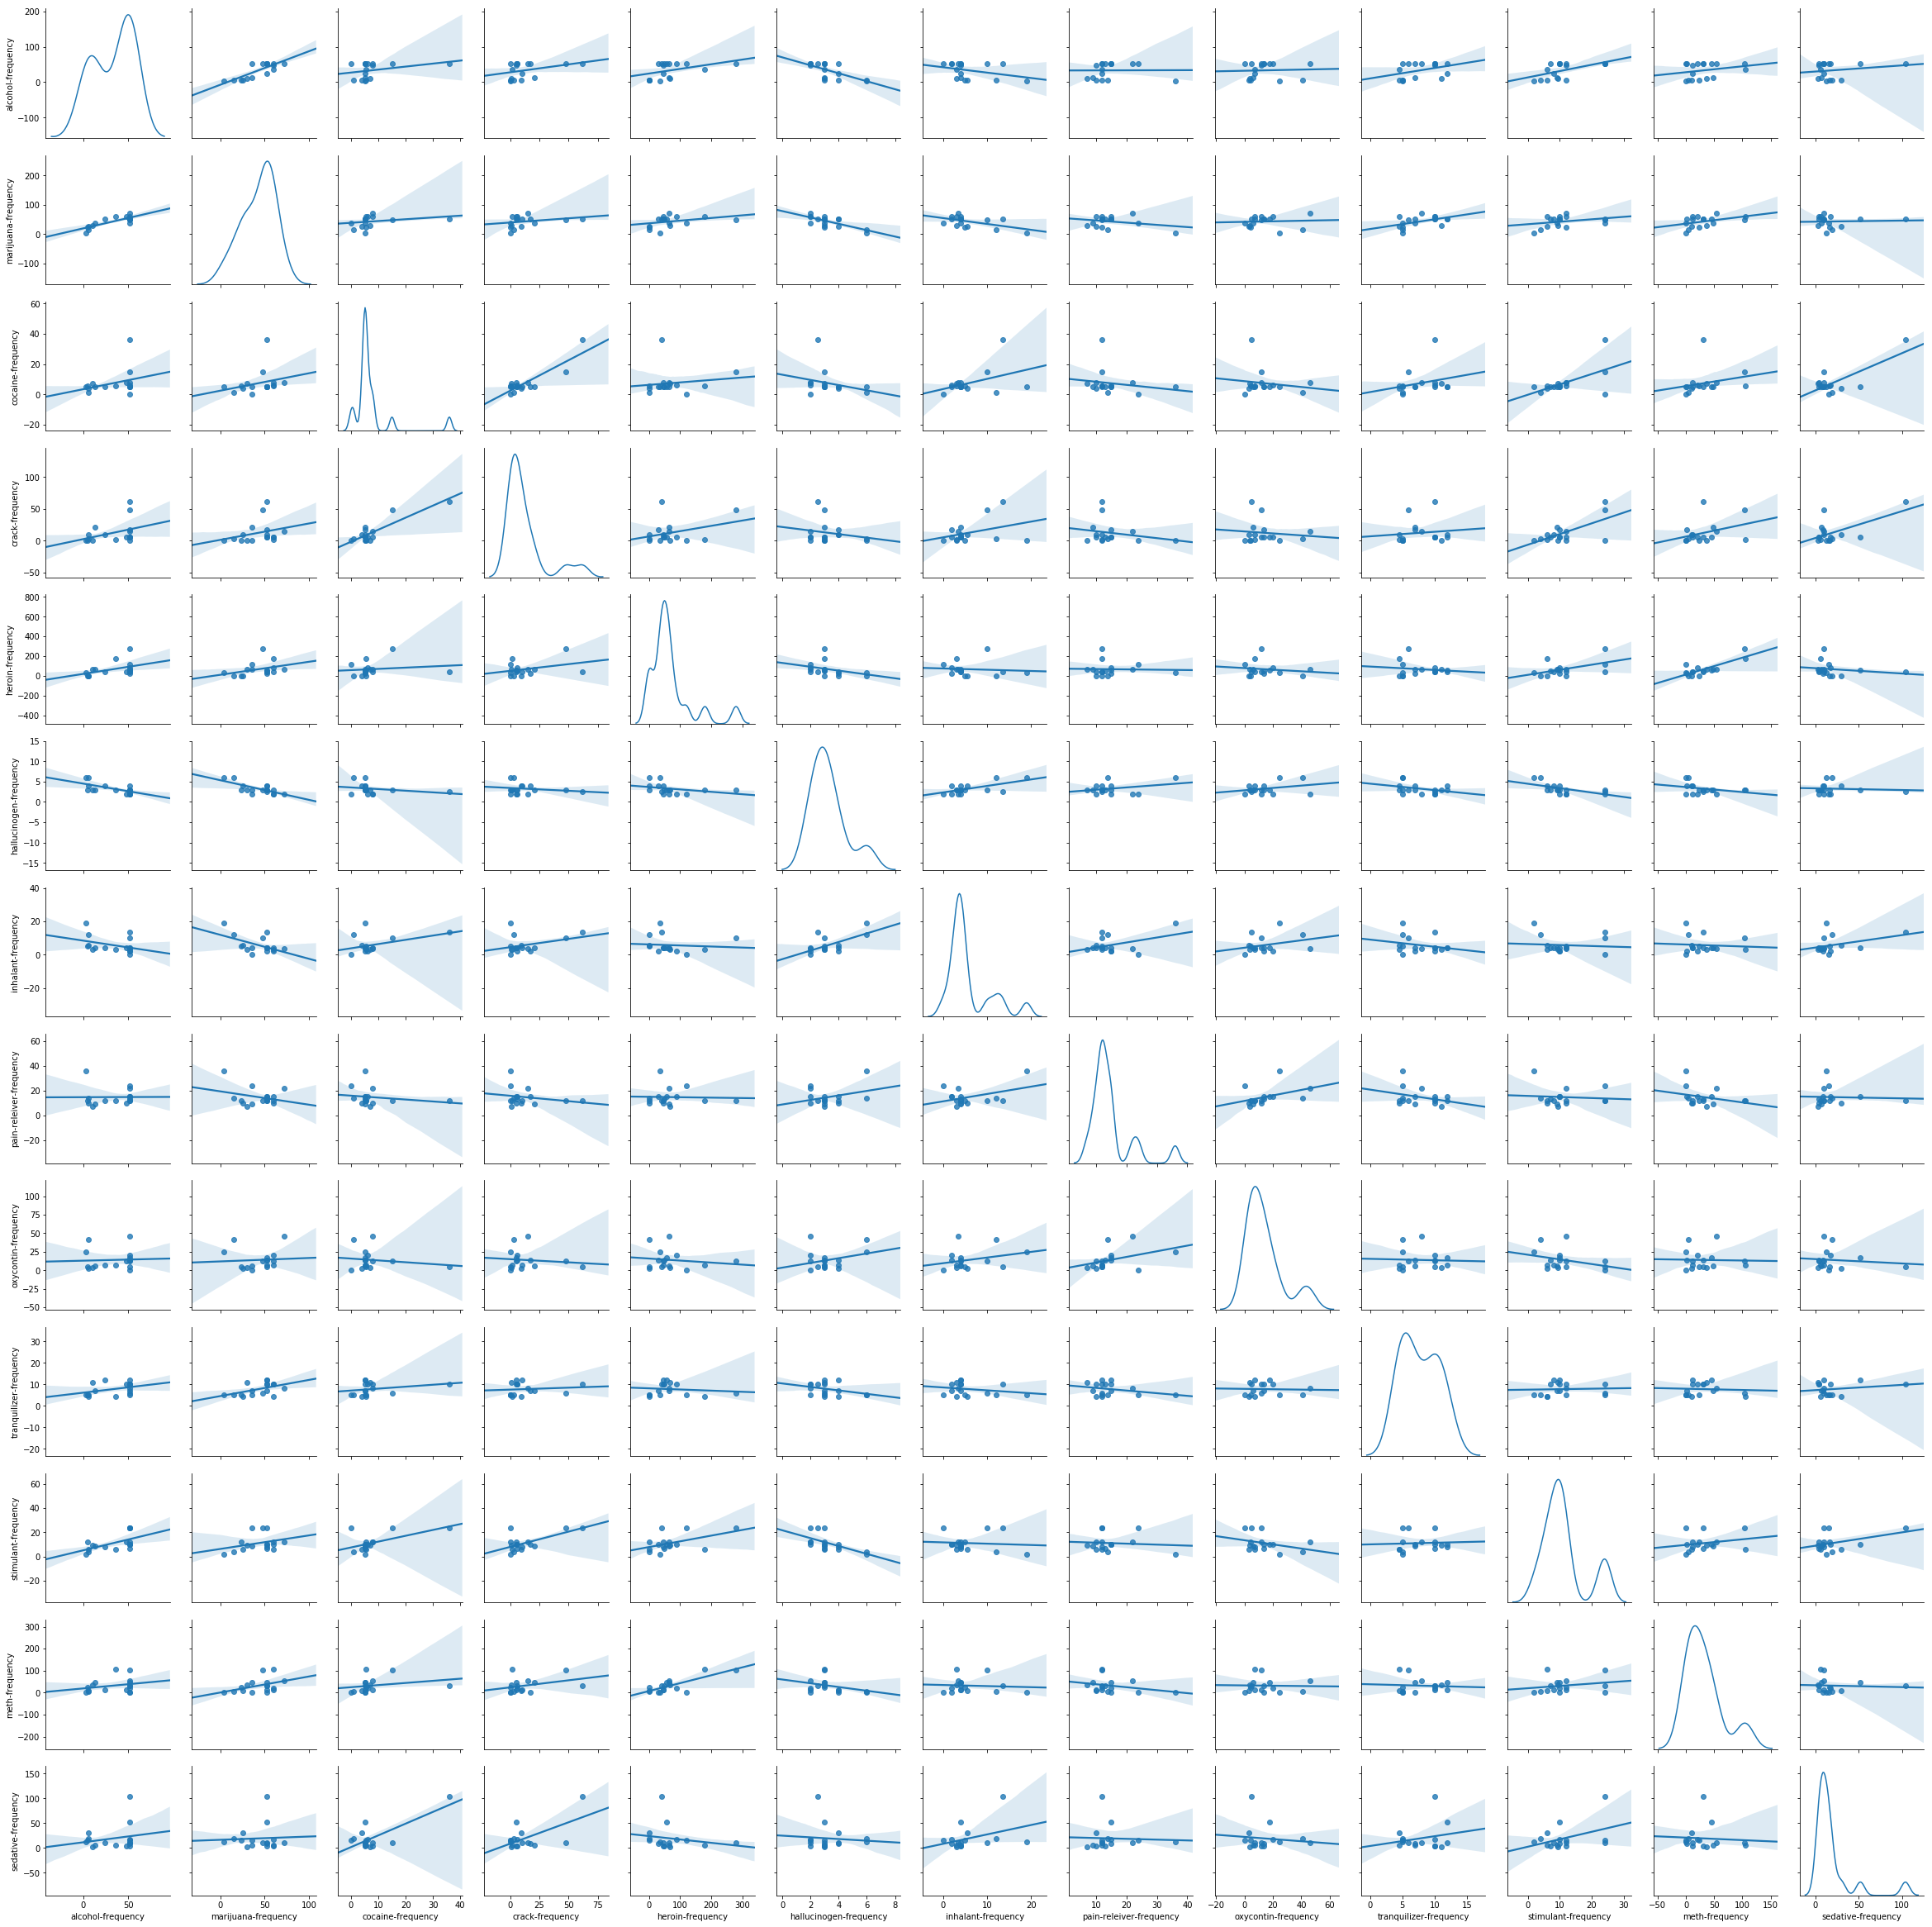

Slide 37
Demographic Classification
The demographic data is available for ages ranging from 12 years to 65+ years. It can be divided into 4 groups –
Minors – 12-21 years
Young Adults – 22 -35 Years
Middle Age Adults – 35 – 65 Years
Old Adults – 65 + years

Slide 38
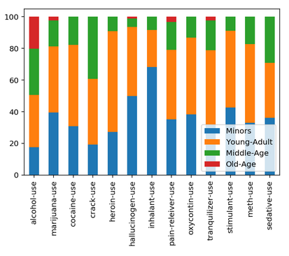
Drug use by percentage
Minors – Marijuana, hallucinogens, inhalants, and stimulants.
Young - Adults: - Heroin, Cocaine, Tranquilizers , oxycontin, Meth and Pain-reliever.
Middle-Age: - Crack, and sedatives
Equal Share: - Alcohol

Slide 39
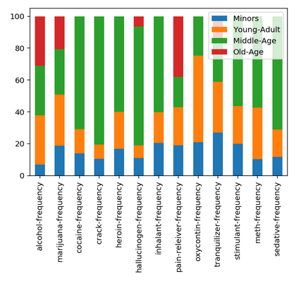
Drug Use by Frequency
Minors: – Tranquilizers, inhalant
Young-Adult: - Oxycontin, Alcohol, Meth.
Middle-Age:- Cocaine, Crack, Heroin, Inhalants, Sedatives, Meth, Stimulants
Old-Age: - Pain-reliever, Alcohol

Slide 40
Any Questions?

